Slide 1




Astronomy 1010 chapter 12
Clayton State University
Slides for Astronomy textbook from OpenStax
https://openstax.org/books/astronomy/

Slide 2
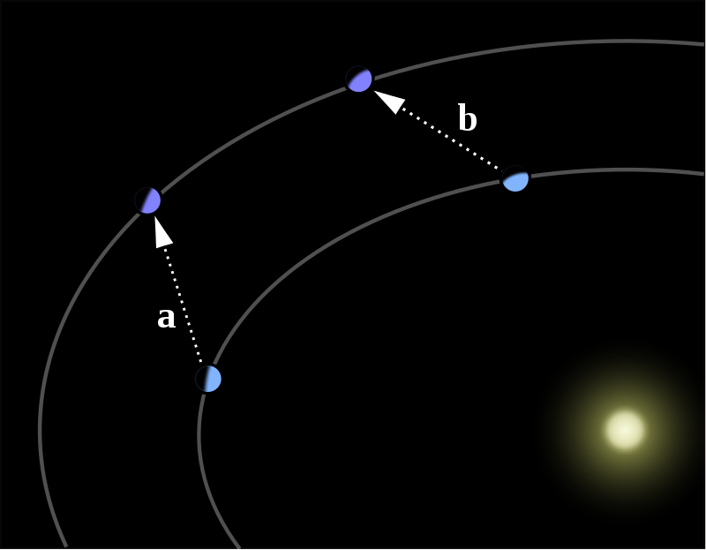
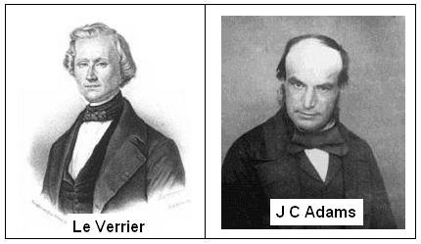
Discovery of new planets
All bodies gravitationally affect each other
This changes trajectories
If know trajectory, can predict effects of known planets and see if that is true
Assume observed deviations due to another planet – calculate its orbit and start looking for it
https://www.youtube.com/watch?v=D07ioIgYAbE

Slide 3
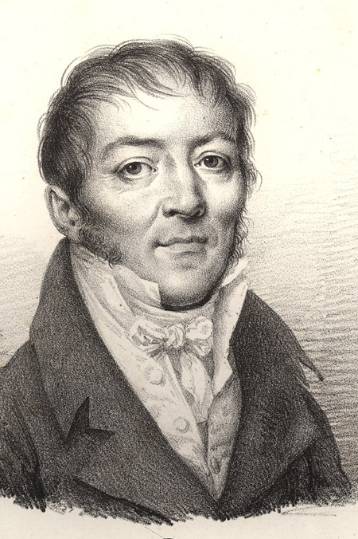
Neptune’s discovery
In 1821, Alexis Bouvard had published astronomical tables of the orbit of Uranus, making predictions of future positions based on Newton's laws of motion and gravitation.
Subsequent observations revealed substantial deviations from the tables, leading Bouvard to hypothesize some perturbing body.

Slide 4
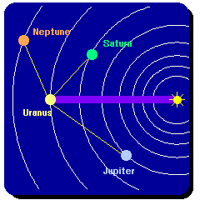
Neptune’s discovery
These irregularities or "residuals", both in the planet's ecliptic longitude and in its distance from the Sun, or radius vector, might be explained by a number of hypotheses:
  the effect of the Sun's gravity, at such a great distance might differ from Newton's description;
  the discrepancies might simply be observational error;
  perhaps Uranus was being pulled, or perturbed, by an as-yet undiscovered planet.
  NOTE that effects from Jupiter and Saturn were accounted for.

Slide 5
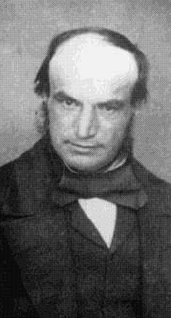
Neptune’s discovery
John Couch Adams learned of the irregularities while still an undergraduate and became convinced of the "perturbation" hypothesis. Adams believed, in the face of anything that had been attempted before, that he could use the observed data on Uranus, and utilizing nothing more than Newton's law of gravitation, deduce the mass, position and orbit of the perturbing body. Adams certainly completed some calculations on 18 September 1845.

Slide 6
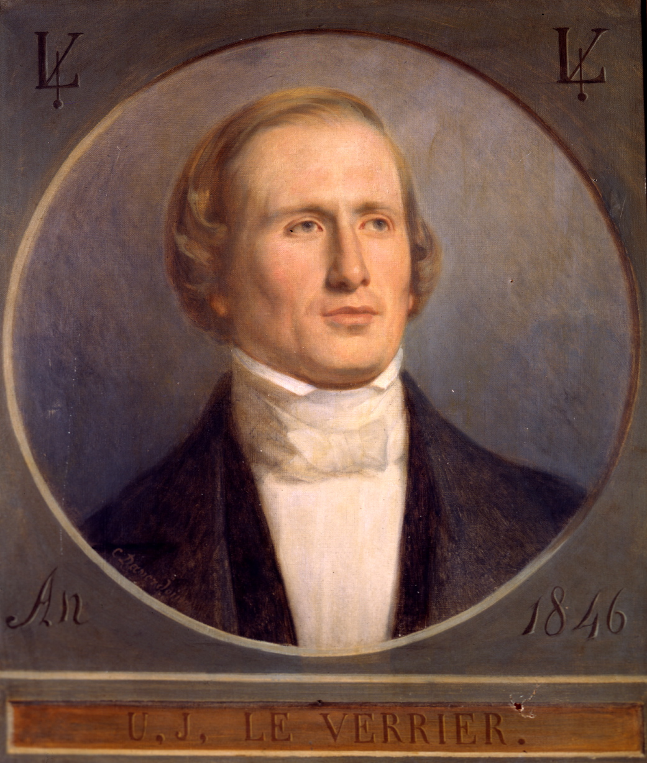
Neptune’s discovery
Meanwhile, Urbain Le Verrier, on November 10, 1845, presented to the Académie des sciences in Paris a memoir on Uranus, showing that the pre-existing theory failed to account for its motion.
Unaware of Adams's work, he attempted a similar investigation, and on June 1, 1846, in a second memoir presented to a public meeting of the Académie, gave the position, but not the mass or orbit, of the proposed perturbing body. Le Verrier gave coordinates to Berlin Observatory where the astronomer Johann Gottfried Galle located Neptune within one degree of its predicted position.

Slide 7
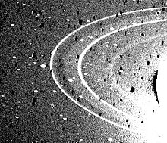
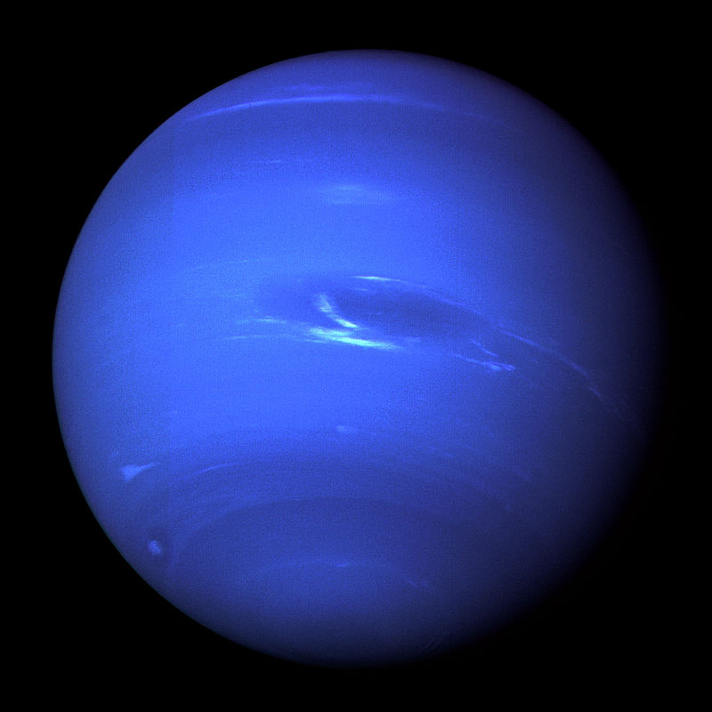
Neptune
Ice giant
17 times the Earth mass
  Note: Uranus is 15 times
Not visible to eye
has active and visible weather patterns
Has rings
Like Jupiter and Saturn, Neptune's atmosphere is composed primarily of hydrogen and helium, along with traces of hydrocarbons and possibly nitrogen, though it contains a higher proportion of "ices" such as water, ammonia, and methane. However, similar to Uranus, its interior is primarily composed of ices and rock
Formed closer to the Sun than Jupiter and Saturn?

Slide 8
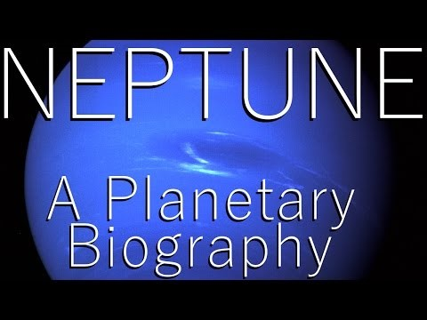
Neptune Discovery

Slide 9
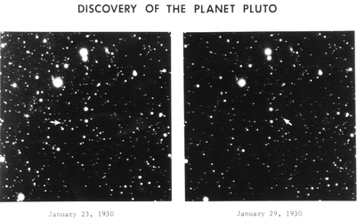
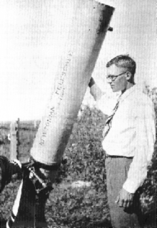
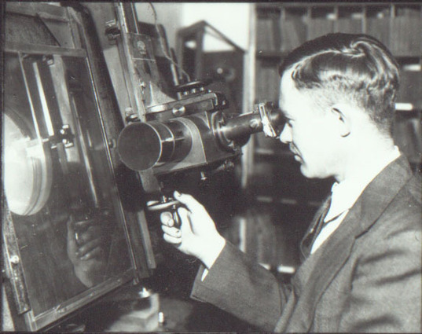
Discovery of Pluto
With increased precision of astronomical measurements, scientists were able to do even better predictions of the orbits of known planets. And small deviations in Neptune’s orbit were found. It was theorized that its yet another planet beyond the Neptune’s orbit.
On February 18, 1930, after nearly a year of searching, Clyde Tombaugh discovered a possible moving object on photographic plates taken on January 23 and 29. A lesser-quality photograph taken on January 21 helped confirm the movement. After the observatory obtained further confirmatory photographs, news of the discovery was telegraphed to the Harvard College Observatory on March 13, 1930. Pluto has yet to complete a full orbit of the Sun since its discovery because one Plutonian year is 247.68 years long.

Slide 10
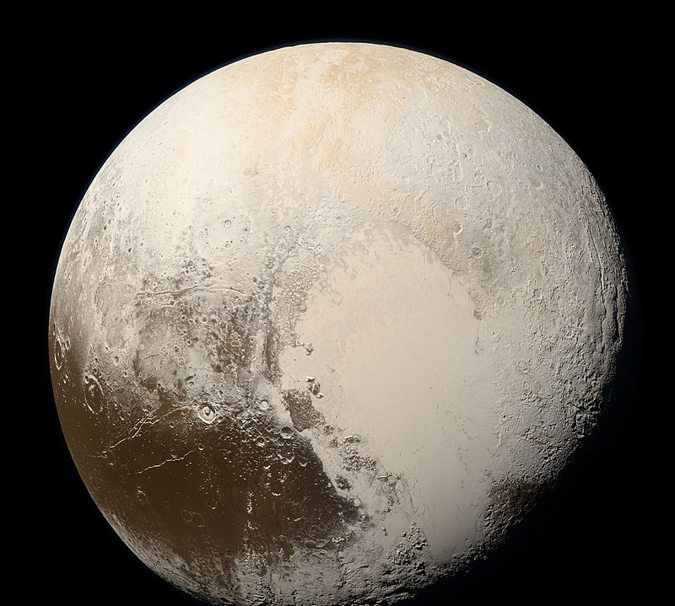
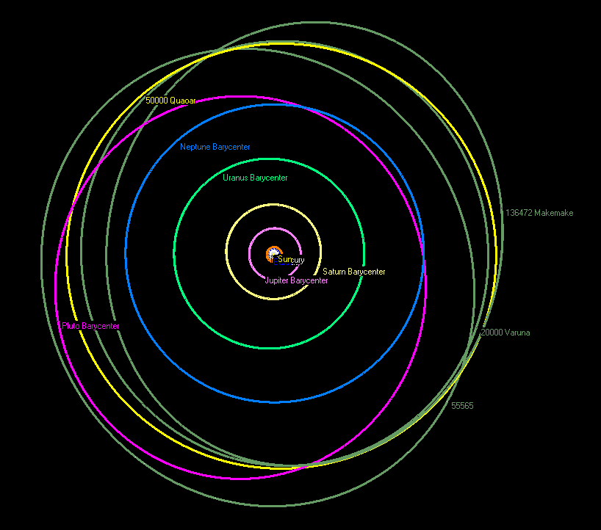
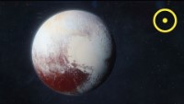
Pluto – planet or not?
Pluto (minor planet designation: 134340 Pluto) is a dwarf planet in the Kuiper belt, a ring of bodies beyond Neptune. It was the first Kuiper belt object to be discovered and is the largest known plutoid (or ice dwarf).
Pluto was discovered by Clyde Tombaugh in 1930 and was originally considered to be the ninth planet from the Sun. After 1992, its status as a planet was questioned following the discovery of several objects of similar size in the Kuiper belt.
In 2005, Eris, a dwarf planet in the scattered disc which is 27% more massive than Pluto, was discovered. This led the International Astronomical Union (IAU) to define the term "planet" formally in 2006, during their 26th General Assembly. That definition excluded Pluto and reclassified it as a dwarf planet.

Slide 11
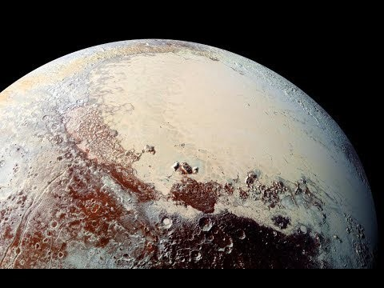
Pluto – New Horizons Probe
https://www.youtube.com/watch?v=6l4kr36TzQ4
Also: https://www.youtube.com/watch?v=NEdvyrKokX4&t=4s

Slide 12

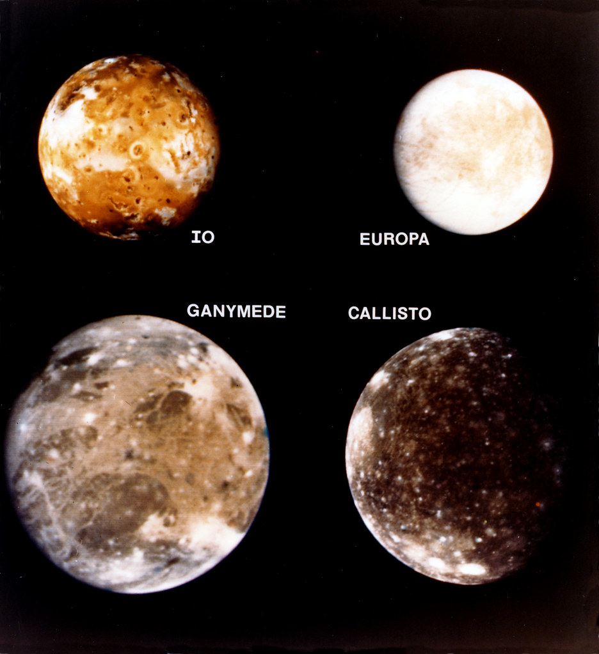
Any questions?
Is life possible on Europa? Should we send a separate mission to investigate?

Slide 13
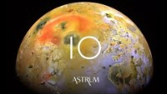
IO up close

